Slide 1

THIRD YEAR OF ENGINEERING
DEPARTMENT OF ELECTRONIC AND TELECOMMUNICATIONS
Project By : Under Guidance of :
Asmita Walke - F21211001 Mrs . Kanchan Tiwari
Divyanshi Rathore - F21211068
Jyotika Kumari - F21211075
Notes:
1

Slide 2

FALL DETECTION FOR ELDERLY PEOPLE
Why We Chose This Topic
In 2050, 30% of the population would be of old people
Product can be used by old people , handicaped people and small childrens too
Notes:
3

Slide 3
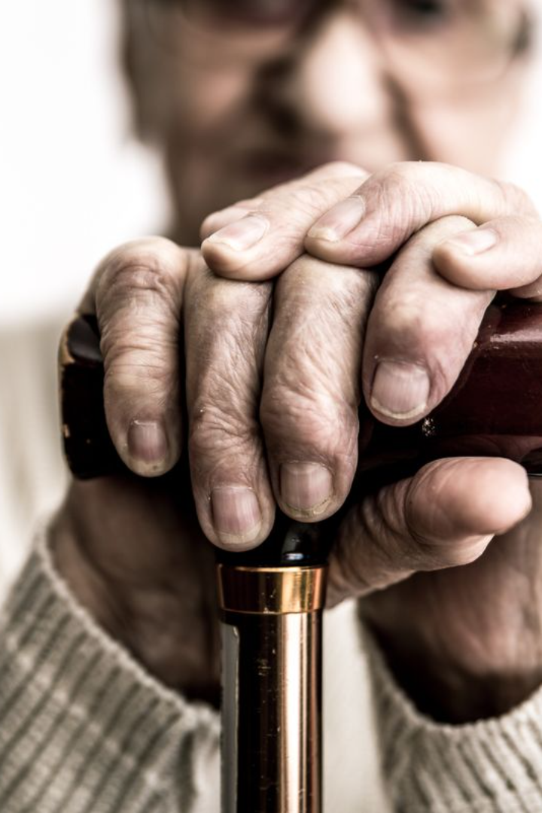
Introduction: Global Problem
Falls among the elderly are a global concern, with significant repercussions on health and independence. Every year, a high number of older adults experience falls, resulting in injuries, hospitalizations, and in some cases, fatal consequences.
Notes:
4

Slide 4
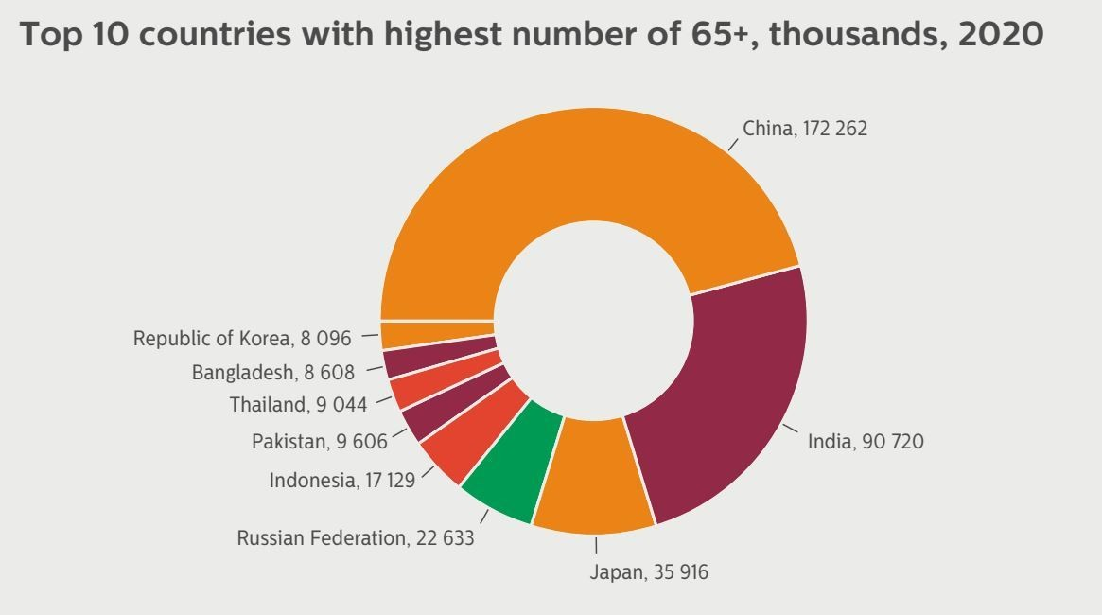

Slide 5
Fall Risk Factors
A person can be more or less prone to fall, depending on a number of risk factors and hence a classiﬁcation based on only age as a parameter is not enough. In fact, medical studies have determined a set of so called risk factors:
Intrinsic
Internal Environment
External Environment
Chronic disease
Poor balance
Low mobility and bone fragility
Sight problems
Cognitive and dementia problems
Parkinson disease
Use of drugs that aﬀect the mind
Need to reach high objects
Slipping ﬂoors
Stairs
Incorrect use of shoes and clothes
Damaged roads
Dangerous steps
Poor lighting
Crowded places.
Notes:
7

Slide 6
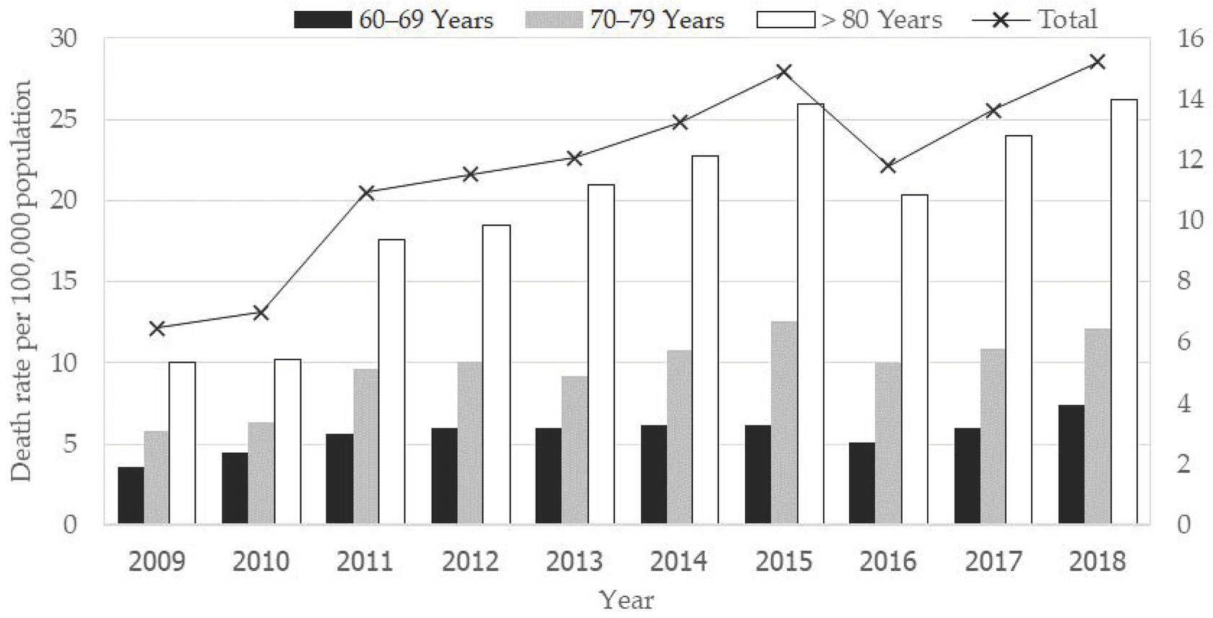
Statistics on falls and injuries among the elderly
Rising Incidents
The statistics reveal a concerning increase in falls among the elderly, leading to injuries, fractures, and reduced mobility.
Notes:
5

Slide 7
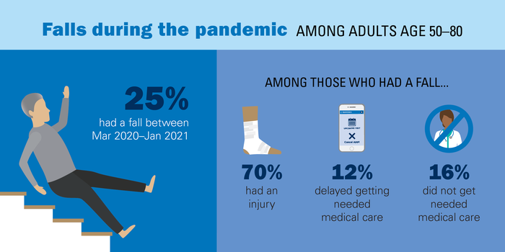
Statistics on falls and injuries among the elderly
Impact on Health
Each fall has substantial implications on the overall health of the elderly, often causing long-term health issues and psychological stress.
Notes:
6

Slide 8
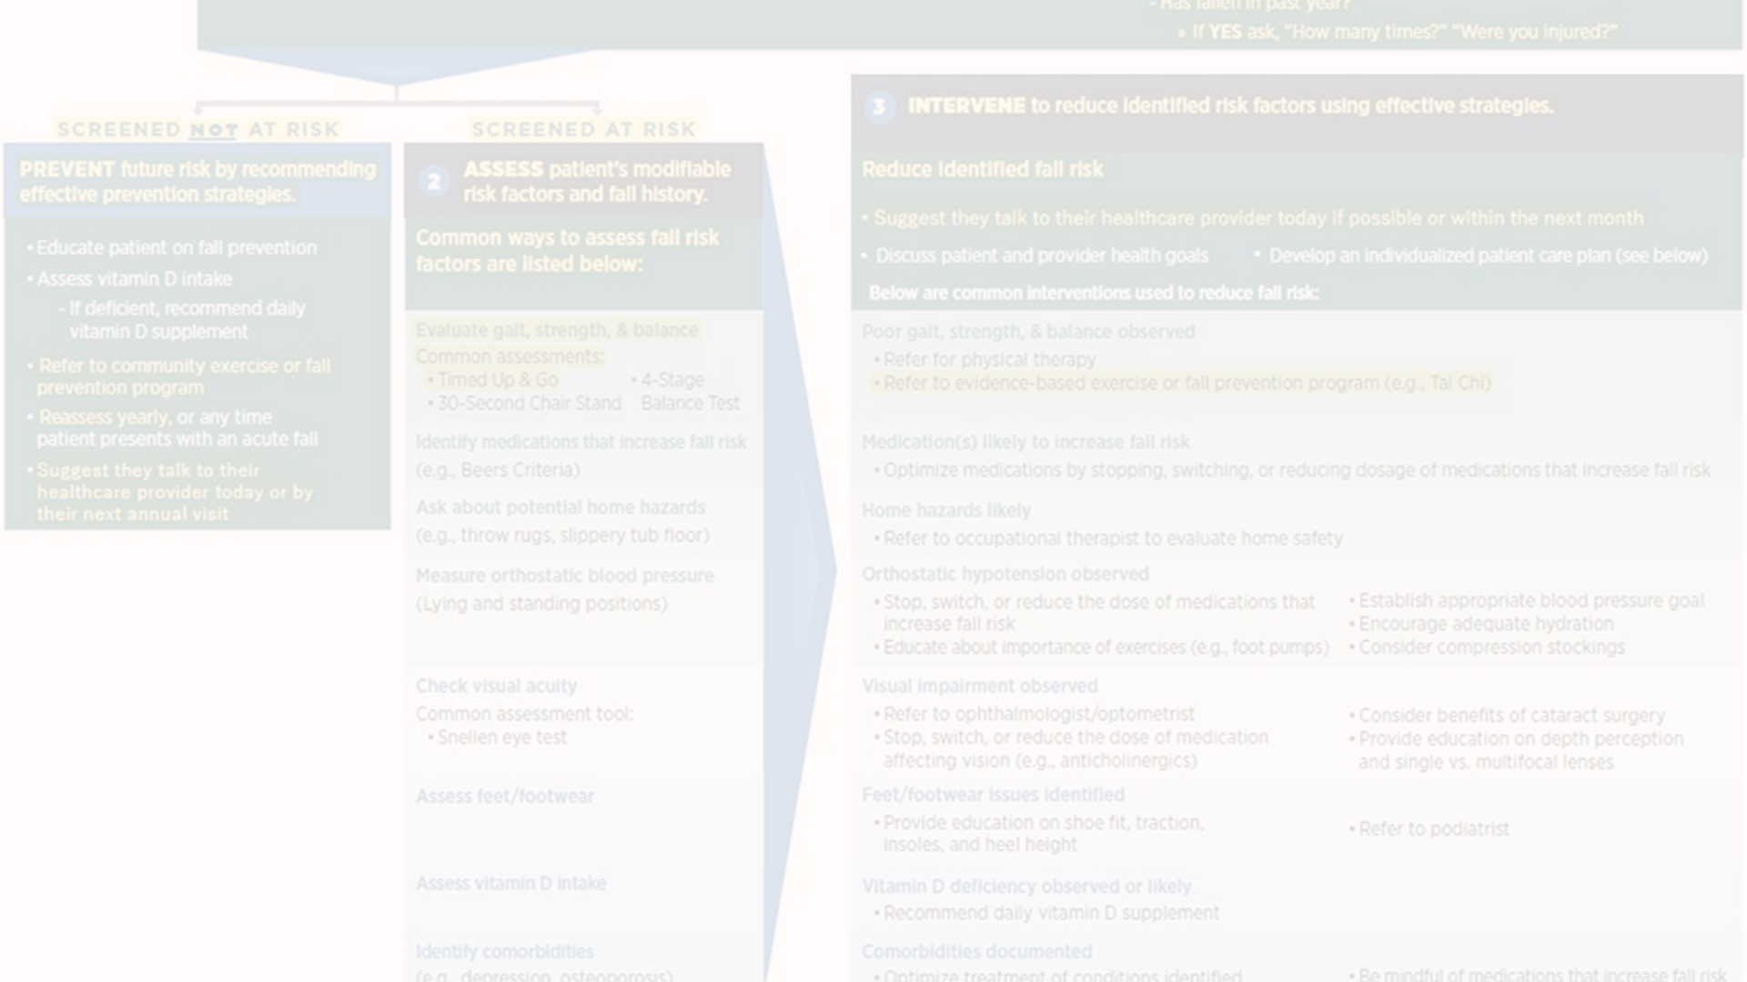
Current fall detection methods
Exercise Programs
Home Safety Modifications
Assistive Devices
While exercise is beneficial, it may not provide comprehensive protection against fall-related injuries for all elderly individuals.
Devices like canes and walkers serve well, but they may not be sufficient in preventing falls in all scenarios.
Adapting homes for safety is effective, but it comes with limitations in addressing sudden falls or accidents.
Notes:
8

Slide 9
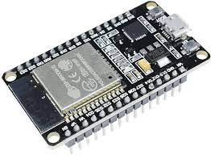
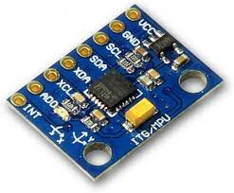
Components Used:
ESP32
MPU6050
Notes:
7

Slide 10
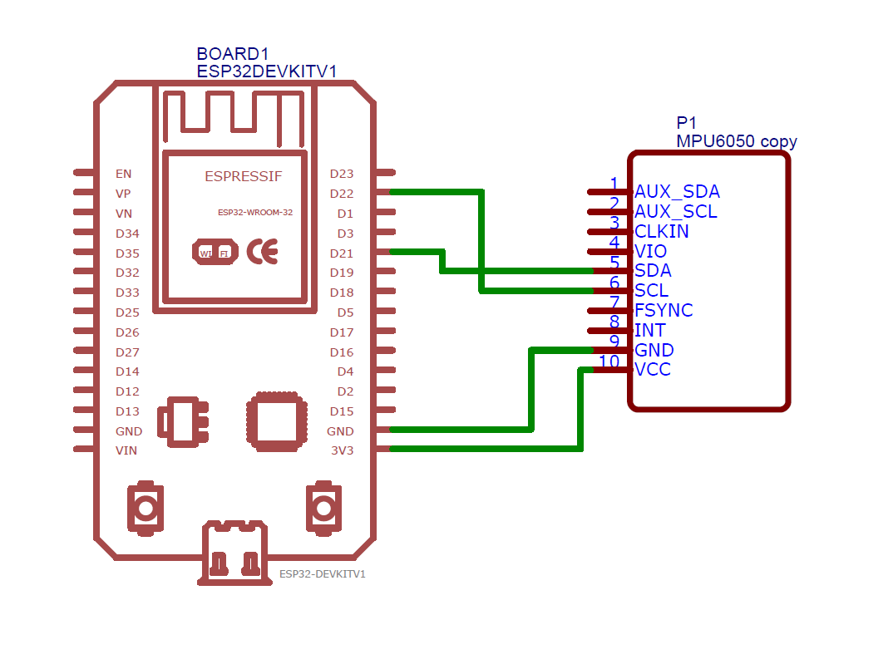
Notes:
8

Slide 11
Block Diagram
Read Accelerometer from MPU6050
Calculate Angle and Angular Velocity/Acceleration
Start
If fall not detected it will start the process again
If 4th block condition satisfies , MPU6050 notifies ESP32 that fall has detected
Checks for higher acceleration and higher angular velocity
Notes:
8

Slide 12
Future developments and potential for widespread use
Technological Advancements
Industry Collaboration
Educational Initiatives
Partnerships between technology developers, healthcare providers, and eldercare organizations drive the advancement and integration of airbag systems.
Efforts to raise awareness and knowledge about airbag technology focus on promoting its benefits and dispelling misconceptions.
Continuous research and innovation aim to enhance the sophistication and reliability of airbag technology for broader applications.
Notes:
13

Slide 13
References:
https://ieeexplore.ieee.org/abstract/document/10147586/
https://www.academia.edu/download/105651467/31990_66651_1_PB.pdf
https://ieeexplore.ieee.org/document/8736227/
https://ieeexplore.ieee.org/document/10374122
https://ieeexplore.ieee.org/document/9797202/
https://ieeexplore.ieee.org/document/9031939/
https://youtu.be/ycAf2J4Ll3o?si=kMcjwWKx63rN2y6-
Notes:
7

Slide 14

Thank you
Notes:
15

